Slide 1








Welcome to Today’s WCET Webcast
FEBRUARY 5, 2026
The webcast will begin shortly. No audio is being broadcast at this time.
A recording of this webcast will be available on the WCET website next week.
WCET events may not be recorded or rebroadcast without our written consent.
Due to previous issues with repurposed content, AI notetakers will be removed.
We apologize for any inconvenience.

Slide 2


Welcome!
Slides can be downloaded via the link in chat.
Please use the Question box for questions and Chat for other information exchange.
Slides, recording, and shared resources will be emailed to attendees.
Megan Raymond
Senior Director, Membership and Programs, WCET
mraymond@wiche.edu

Slide 3
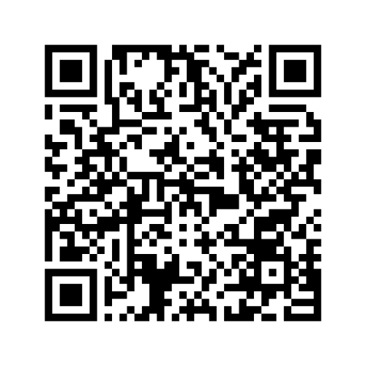
Accessibility Commitment
WCET is committed to creating inclusive and accessible materials. Our slides are designed with high-contrast visuals, large text, and descriptive alt text for images.
You can scan the QR code to download the slides (PPT file) on your phone if you prefer.
If you need the slides in an alternative format or additional accommodations, please let us know. We value your feedback to make our content accessible for everyone.
Notes:
Megan intro

Slide 4
Practical Strategies for Driving AI Policy Adoption in Higher Ed
February 5, 2026
Notes:
Megan

Slide 5

Hosted in partnership with:
Notes:
Megan

Slide 6
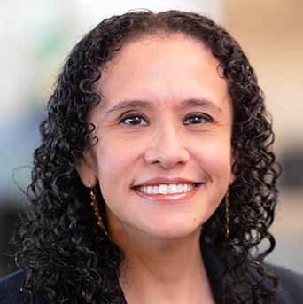
Today’s Moderator
MICHELLE SINGH
VP for Strategic Educational Alliances
University of North Texas
Michelle.Singh@unt.edu
Notes:
Megan hand over to Michelle

Slide 7
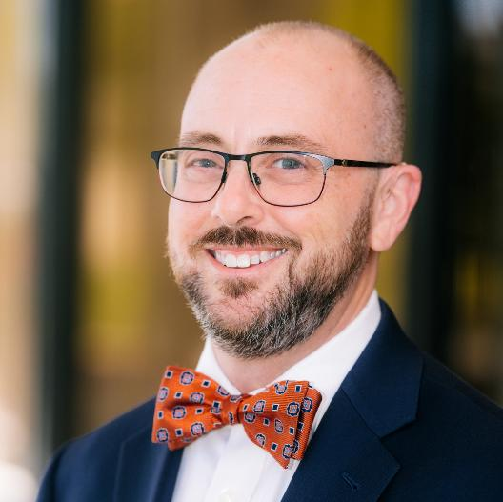
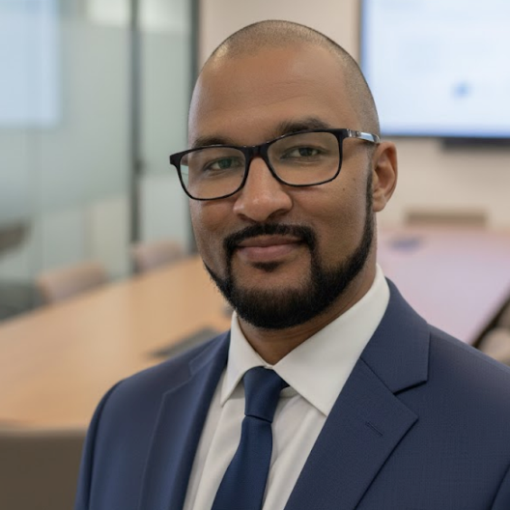
Speakers
VAN DAVIS
PAUL MORALES
Executive Director
WCET
vdavis@wiche.edu
CISO
Honorlock
pmorales@honorlock.com
Notes:
Michelle > Van > Paul
Michelle to provide commentary to segway into Paul’s slide

Slide 8
2026: Understanding New AI Complexities
The rise of auditability on governance and accreditation bodies.
The rise of agentic AI and how it influences student success, integrity, and fraud.
AI literacies and their impact on the existing digital divide.
Notes:
Paul (priority slide)
AI is a complex topic, it becomes even more complex with the governance and accreditation bodies most likely beggining to demand and audit your AI policies
Box 1
Accreditation are bodies leaning into auditing policy and not just accepting at face value:
- July 25’ Middle States Commision on Higher Education : https://www.msche.org/2025/07/02/new-use-of-artificial-intelligence-accreditation-policy-and-procedures/
- In as early as Dec of 24’ Southern Association of Colleges and Schools (SACSCOC) published their guidelines : https://sacscoc.org/app/uploads/2024/12/AI-in-Accreditation.pdf
-It is clear that the wave of AI goverance is coming to stay, don't wait, get ahead of it. I also highly suggest trying to be a part of the development if at all possble.
Box 2
-Difference between Generative AI Chatbots and Agentic AI
-Humans will transition more from interacting with a LLM to overseeing a team of specialized AI agents in the workforce
2023: We worried about students using AI to write a essay.
2026: We are worried about "Shadow Students" (agents) attending an entire online program.
Box 3
-The baseline of AI literacy has been raised to chatting and now moving toward managing agents | This will begin become the career differentiator . Especially in fast pased resource restrictive roles
- Access to premium AI tools by wealthy students further expands the digital divide. Ex. Deep Research paid tiers in Gemini or Chatgpt plus

Slide 9
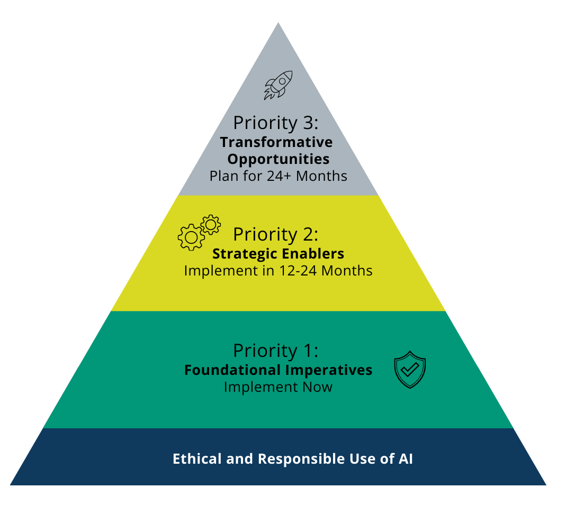
A Prioritized Adoption Roadmap
Your institution has established an AI policy, so what’s next?
Priority 2: Strategic Enablers
Enhance institutional capabilities, drive operational efficiency, and systematically improve the quality of teaching, learning, and student support.
Priority 3: Transformative Opportunities
Redefine institutional models, create new forms of value, and foster deep, sustainable innovation and partnerships across campus and beyond.
AI Education Policy, Guideline, and Practice Ecosystem Framework
Notes:
Van (priority slide)

Slide 10
Ethical and Responsible Use of AI
Fair
Accountable
Secure
Transparent
Educated
Relevant
“By proactively establishing an ethical ecosystem, higher education can harness the transformative potential of AI to enrich the educational experience for all.”
AI Education Policy, Guideline, and Practice Ecosystem Framework
Guide on the Use of Generative Artificial Intelligence
Notes:
Van

Slide 11
Strategies to Drive AI Adoption
Notes:
Van - look at strategies, most successful is cross functional teams
Michelle then to add commentary on the success of cross functional teams then it goes to Van + Paul on slide 7
Michelle commentary - not reinventing the wheel

Slide 12
Cultivate Cross-Functional Teams
Integrate diverse perspectives to lead the cultural shift toward AI literacy.
Students
Faculty
Instructional Designers
LMS Admins
Academic & Student Affairs
Accessibility & Academic Support
C-Suite
Procurement
Legal
IT and CISO
Notes:
Van + Paul
Van - the importance of creating a large table and the importance of student voice (bring them in a a key stakeholder is critical)
Paul - to keep it broad, discuss possible controls for this strategy, partnering with IT/security to ensure controls are in place. This ensures that your infosec group doesn’t become a blocker to momentum with the initiative.
Get the right people at the table - cross functional teams that include students to be involved in policy discussions, accessibility is key, IT/CISO, heading LMS, instructional designers (boots on the ground), C-suite
Involve procurement office - legal reproductions
Incorporate the student voice

Slide 13
Replace Rigid Policies with Iterative Frameworks
The speed of AI innovation creates a 'decay rate' for policies. To maintain fluency, we must transition from fixed policies to adaptive strategies.
Institutionalize Agility
Build a recurring "Revisit & Refine" cadence into the core institutional AI roadmap.
Calibrate for Reality
Regularly pressure-test existing practices against the latest AI tool benchmarks.
Evolution as a Strategy
Treat policy updates not as "fixes," but as optimizations for better adoption and usage.
Notes:
Van (priority slide)

Slide 14
Develop Relationships with Industry Partners
Combining industry insight with adaptive policy to forge workforce-ready graduates.
Toolset: Which AI platforms are non-negotiable?
Skillset: How do we amplify the "uniquely human" edge?
By embedding industry expectations into curriculum and assessments, it ensures graduates leverage AI to amplify the skills that machines can’t replicate.
Notes:
Van

Slide 15
Audit for Employability
Beyond the tools, how do you expect graduates to frame and translate complex problems for AI-assisted solutions?
Where is the 'Human-in-the-loop' most critical in your workflows, and what durable skills are now your highest priority?
How do you measure a candidate’s ability to fact-check AI outputs and maintain rigorous critical discernment?
What mindsets must our graduates possess to remain effective as your AI tech stack continuously evolves?
Notes:
Van + Paul
Van to take the lead talking about beyond the tools and the importance of human-in-the-loop, Paul to add commentary on what mindset graduates need to have from an employers perspective
What are the core capabilities that students need to have, what mindsets do you need employees to have
What do you need that is uniquely human
Constantly changing
Paul:
While it is tempting to chase the tech, focus on developing problem solving skills, critical thinking skills
How strong their fact checking skills are – we are seeing a rise in real time assessment during interviews, sometimes in a controlled environment and other times watching how the candidate could and would interact with an AI model or other automation tool.
How do you take a problem and frame it in a way that your tools can help you solve
Where is the human in the loop? the most expensive employee is the one who trusts AI blindly. The most valuable is the one who uses AI to scale, but remains the ultimate arbiter of the truth.
They need to possess a unique set of skills - cultural understanding, communicate in a diverse world and most importantly flexibility.

Slide 16
Embrace the Pedagogical Pivot
AI isn’t an addition to the curriculum, it is the new engine of the curriculum.
Assessment and AI
Consider shifting the focus of assessments that focus primarily on knowledge to those that assess knowledge, abilities, and skills.
Grade the Process
Require students to submit their AI conversation logs. Assess their ability to steer, fact-check, and refine the machine's output.
Move from "Teaching AI" to "Teaching with AI"
Don’t make AI a standalone unit. Embed it into existing labs, creative projects, and case studies to demonstrate real-world workflow.
Notes:
Van
Rethinking assessment - rethinking curriculum > shifting from knowledge to application
Faculty is not trained in pedagogy
Best way to teach AI is to embed it

Slide 17
Protect the Integrity of Assessments
Balancing AI exploration and learning with secure validation using online proctoring.
Practice vs. Performance Framework
Use AI for drafting, simulations, and case analysis and proctored sessions for knowledge checks and competency mastery.
AI-Powered Authentic Assessments
Integrate AI into assignments, then use proctored reflection quizzes to verify the student’s actual decision-making and process.
By securing the environment, we verify genuine learning gains,
ensuring the degree remains a trusted signal to industry partners.
Notes:
Paul
As we expand the boundaries of how students learn with AI, we must be equally intentional about how we validate that learning. Honorlock’s secure proctoring creates the 'Safe Harbor' where experimentation meets accountability. This holds to be even more imporant with distance learning and the remote work enviornment.
Focus on using a Practice vs. Performance framework: students iterate with AI to learn, but we use secure environments to verify their mastery. This ensures the degree remains a trusted signal that a graduate has the independent judgment to lead AI, not just follow it.

Slide 18
Detect and Block AI Tools, If Necessary
If we are asking students to engage with AI, we must have a robust mechanism to ensure that validation remains uniquely human.
Honorlock provides a secure environment against AI-powered academic dishonesty by tracking and blocking 15000+ extensions.
If blocking AI is necessary, utilize online proctoring
technology to help stay on top of AI trends.
Notes:
Paul
In November of 2022 (when chatgpt was released to the public) , everyone had an idea of how it would affect academic integrity.
What we didn’t know was the real threat to distance learning and remote testing would come in the form of extensions.
How extensions work
How Honorlock tracks and blocks these extensions
https://honorlock.com/blocking-ai-tools/

Slide 19
Beyond Adoption: Leading the AI Evolution
AI is the engine, but human discernment is the driver. By securing our assessments and syncing with industry, we don’t just teach students how to use AI, we teach them how to lead it.
Integrate: Break the silos to build a cross-functional AI ecosystem.
Iterate: Move from static policies to dynamic, living governance.
Validate: Pair AI-powered pedagogy with secure, trusted integrity.
Align: Ensure graduates carry the unique human skills industry demands.
Notes:
Michelle

Slide 20
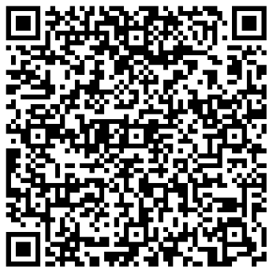
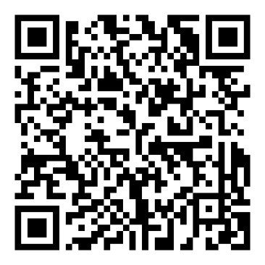
Essential Tools to Streamline AI Adoption
Download the Ecosystem Framework
Architect your policy, guidelines, and practices in one view
Get the AI Policy
Template
Plug-and-play AI statement to align your institution instantly
Notes:
Paul
Then open for QA

Slide 21

AUDIENCE QUESTIONS

Slide 22
Stay Connected
WCET is the leader in the practice, policy & advocacy of
digital learning in higher education.
We envision a future where high-quality digital learning fosters success for educators and learners.
Learn more about the benefits of joining our community: wcet.wiche.edu/join-us

Slide 23
Additional Information and Resources
The webcast recording and additional resources will be available in the next week: wcet.wiche.edu/events/webcasts.
Visit wcet.wiche.edu to explore our Policy and Practice work, Events, Membership, and Sponsorship.

Slide 24
Upcoming WCET Events
Learn more and register: wcet.wiche.edu/events
For WCET members:
  Human-Centered Design in an AI World: Quality and Student Success – February 20, Noon MT
  Policy to Practice Summit – February 26, 11 AM – 4:30 PM ET
Beyond Disclosures: Proactive Professional Licensure Compliance in Higher Education – March 4, Noon MT

Slide 25











Thank You to Our Annual Sponsors
CHAMPION SPONSOR
LEADER SPONSOR
Learn more about the partners that support our work: wcet.wiche.edu/sponsorship/
wcet-sponsors
SUPPORTER SPONSOR

Slide 26
Thank You to Our Supporting Members
Brigham Young University
The California State University
Colorado State University
Michigan State University
The University of Arizona
University of
California
University of
Florida
Supporting members make an additional investment and support WCET’s mission
to advance the effective use of technology for teaching and learning.

Slide 27

THANK YOU FOR ATTENDING!

