Slide 1








Welcome to Today’s WCET Webcast
MARCH 4, 2026
The webcast will begin shortly. No audio is being broadcast at this time.
A recording of this webcast will be available on the WCET website next week.
WCET events may not be recorded or rebroadcast without our written consent. Due to previous issues with repurposed content, AI notetakers will be removed. We apologize for any inconvenience.

Slide 2


Welcome!
Slides can be downloaded via the link in chat.
Please use the Question box for questions and Chat for other information exchange.
Slides, recording, and shared resources will be emailed to attendees.
Megan Raymond
Senior Director, Membership and Programs, WCET
mraymond@wiche.edu

Slide 3
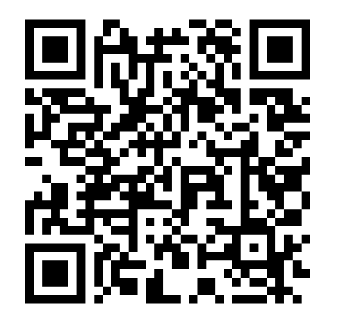
Accessibility Commitment
WCET is committed to creating inclusive and accessible materials. Our slides are designed with high-contrast visuals, large text, and descriptive alt text for images.
You can scan the QR code to download the slides (PPT file) on your phone if you prefer.
If you need the slides in an alternative format or additional accommodations, please let us know. We value your feedback to make our content accessible for everyone.

Slide 4
Beyond Disclosures: Proactive Professional Licensure Compliance in Higher Education
March 4, 2026

Slide 5

Hosted in partnership with:
Notes:
Megan

Slide 6
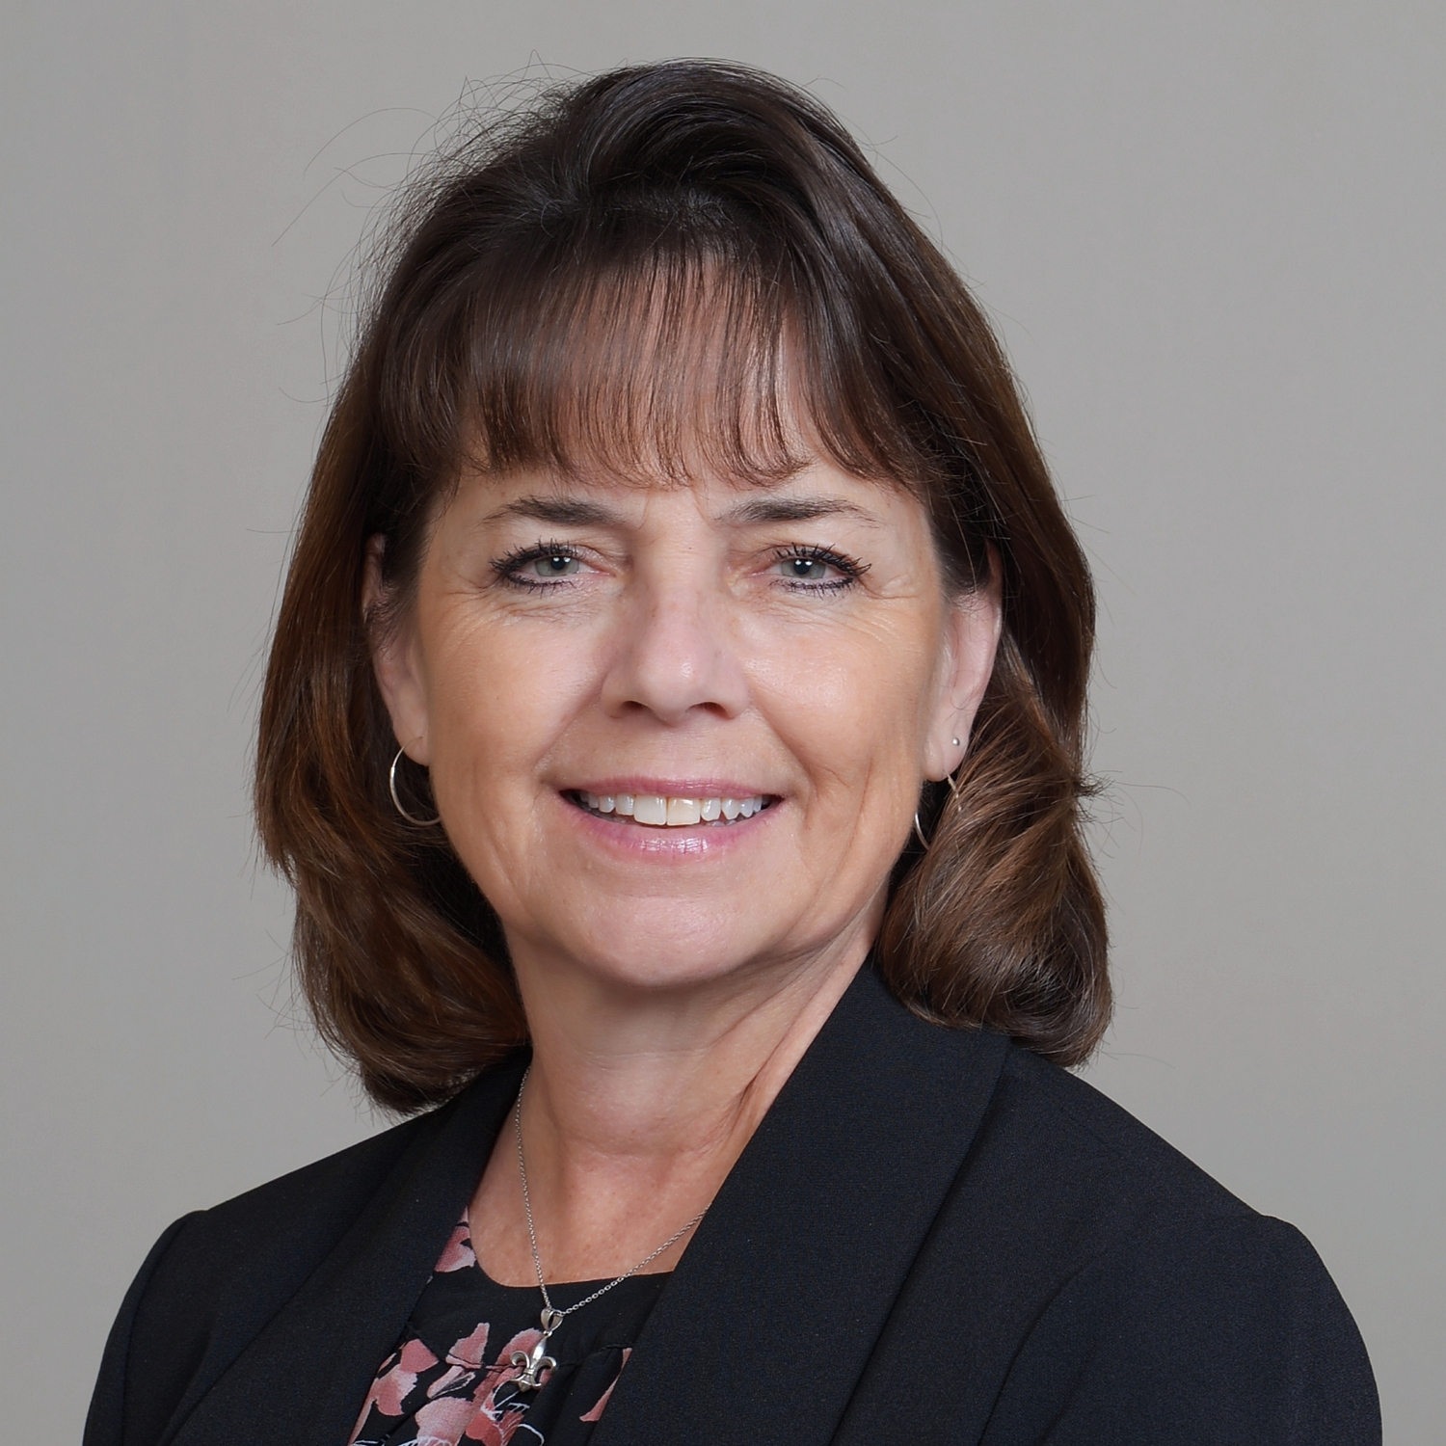
Today’s Moderator
Cheryl Dowd
Senior Director, State Authorization Network & WCET Policy Innovations
cdowd@wiche.edu
https://wcetSAN.wiche.edu

Slide 7
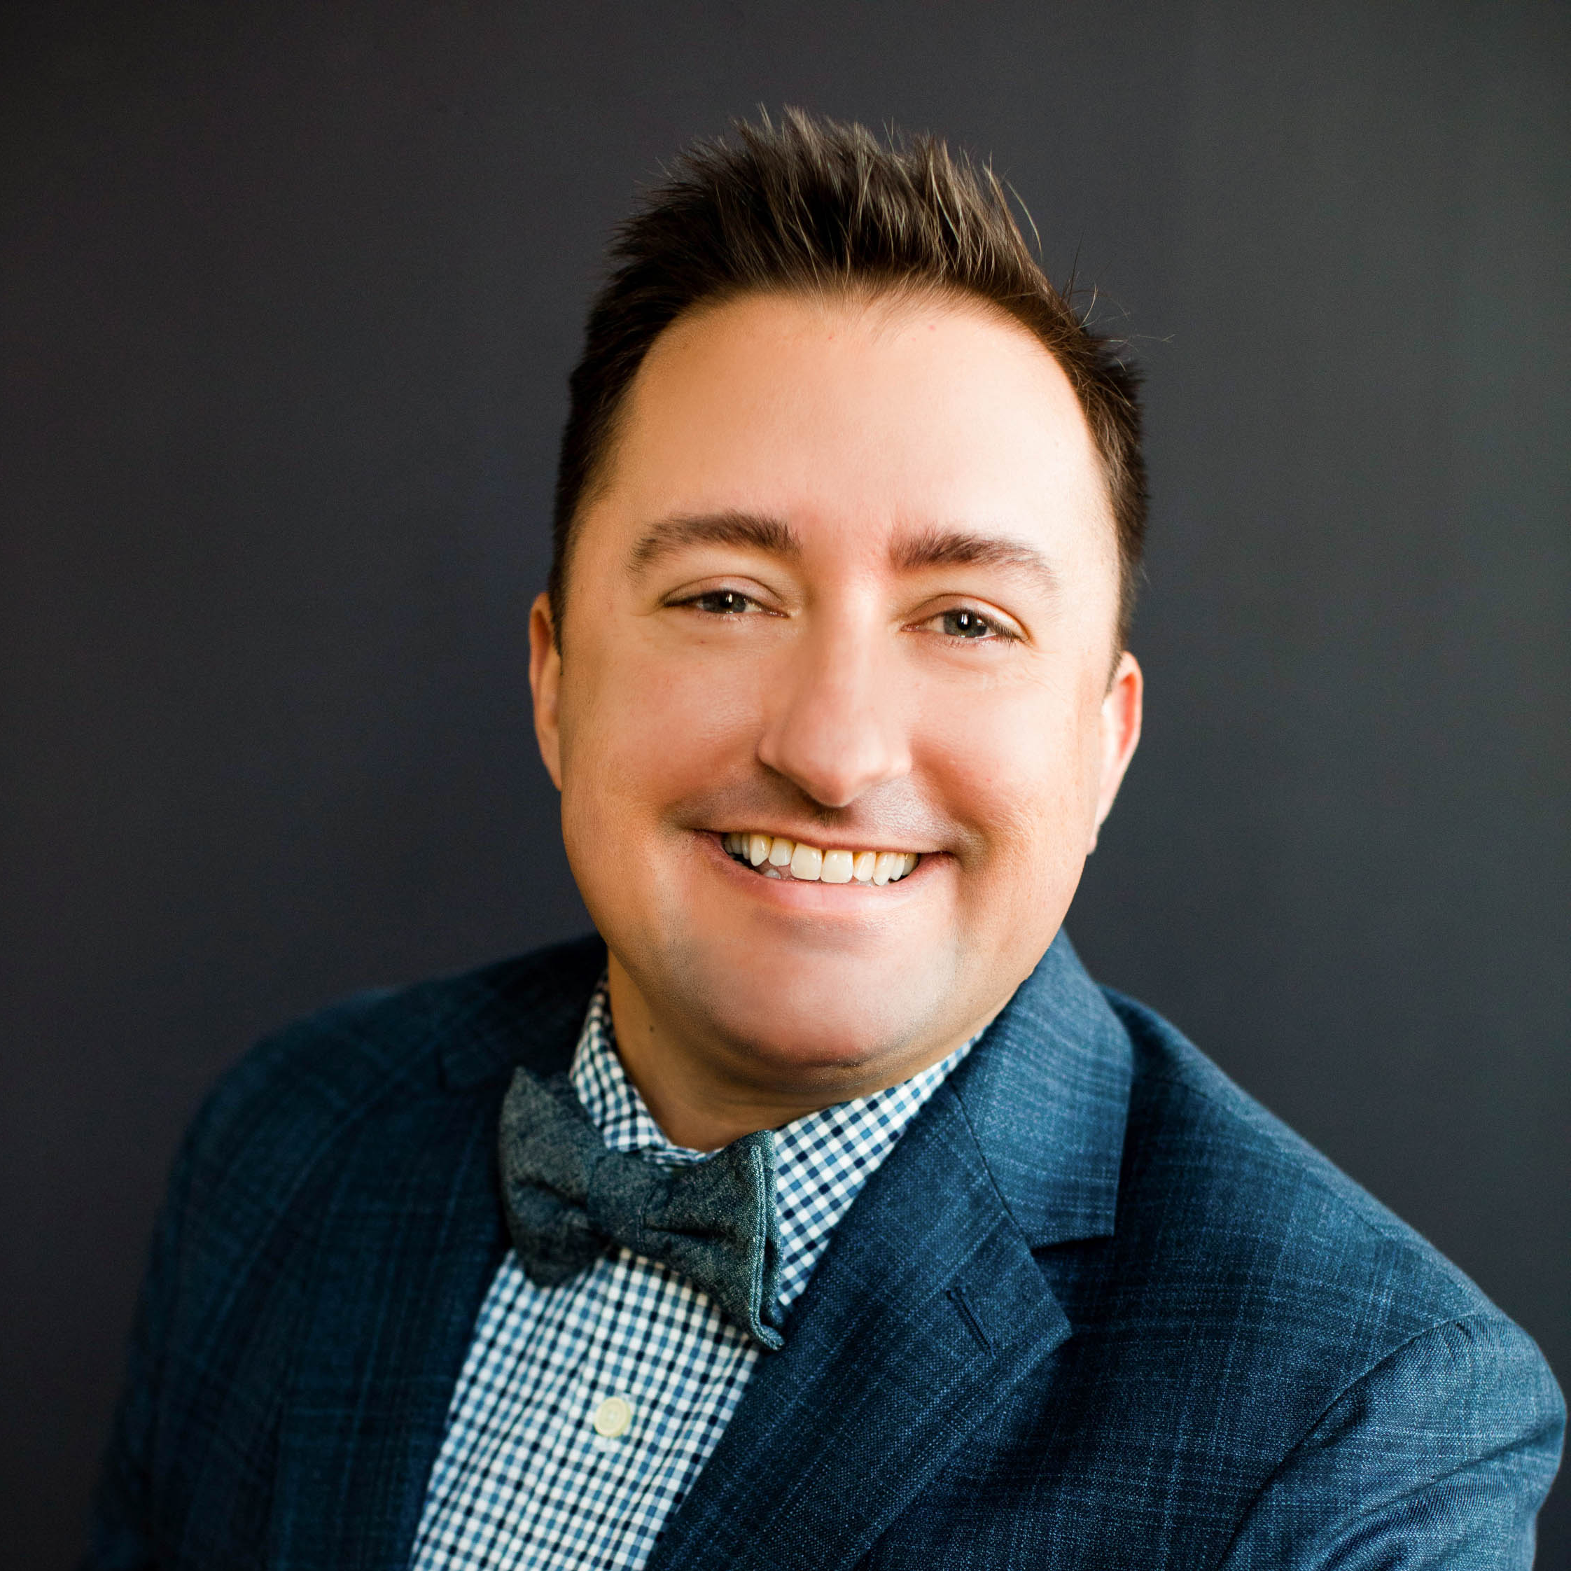
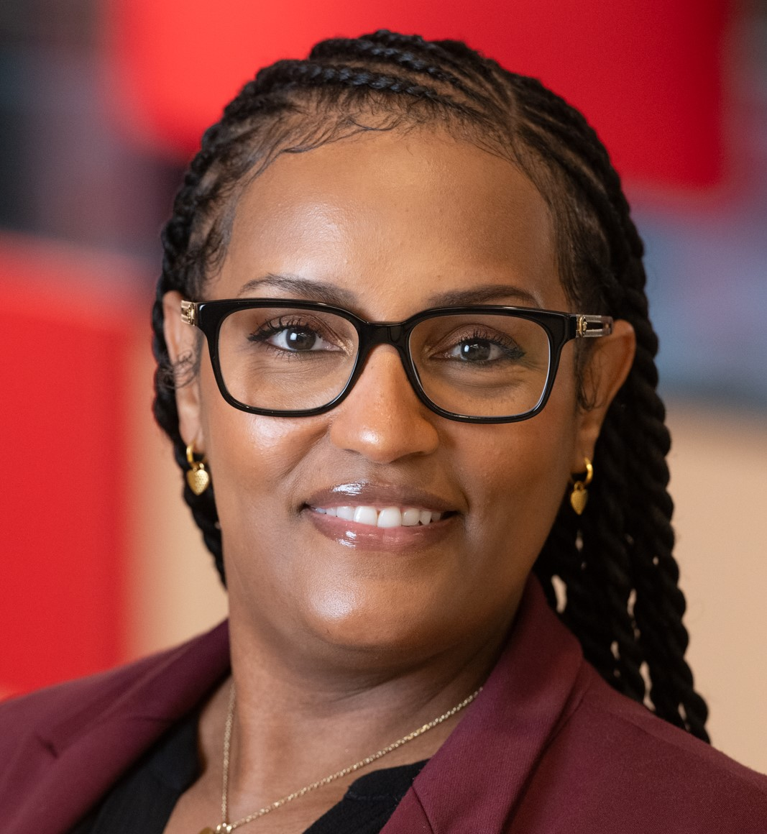

Speakers
KRIS MAUL
Tammy T. Moore
Cynthia pascal
Co-founder and Principal
Higher Education Licensure Pros (HELP) LLC
kris@higheredlicensurepros.com
Manager, Federal, State and Licensure Compliance
Southern Illinois University Edwardsville
linkedin.com/in/tmoore27
Associate Vice President of eLearning
Northern Virginia Community College | NOVA Online
cpascal@nvcc.edu

Slide 8
Orienting Ourselves
Overview of Requirements

Slide 9
Understand. Certify. Communicate.
Title IV Regulations (34 CFR § 668.43 and 34 CFR § 668.14)
Enrollment limitations
Student location
Pell-Eligible Prison Programs (34 CFR § 668.236)
Must disclose criminal history limitations
Student location
Veterans Affairs Rule (38 CFR § 21)
Where State Approving Agency (SAA) only

Slide 10
Understand. Certify. Communicate.
SARA Policy (§ 5.2)
Extends federal responsibilities to all non-Title IV offerings
Even courses through third-parties
State Licensing Board Requirements
Nursing (and some others)
Range from notification about clinicals to full institutional/program review and approval

Slide 11
Understand. Certify. Communicate.
Student Location Policy
Initial enrollment
Change of location
Written Attestation Exception
One "meets" state
Public Disclosures
"Meets" or "Does not meet"
Pell-eligible Prison
VA
Individual Direct Disclosures
Work Required
Research state requirements
Compare curriculum
Make "meets" or "does not meet" determination
Enroll or advertise/recruit
Document
Coordinate

Slide 12
Policies, Processes, and a Proactive Approach
Panel Discussion

Slide 13

AUDIENCE QUESTIONS

Slide 14
State Authorization Network Information and Resources
Visit wcetSAN.wiche.edu to explore State Authorization Network Resources, Membership, and Events addressing professional licensure compliance management and other interstate activity compliance issues.
Survey Report: Findings on the True Scope of Licensure Compliance (2026) wcetsan.wiche.edu/resources/between-lines-behind-work-survey-findings-true-scope-licensure-compliance
WCET Frontiers: Certifying Compliance in an Uncertain Landscape: wcet.wiche.edu/frontiers/2026/02/12/certifying-compliance-in-an-uncertain-landscape-survey-findings-on-the-impact-of-professional-licensure-requirements
Professional Licensure Requirements Handbook: wcetsan.wiche.edu/resources/professional-licensure-requirements-handbook-2024

Slide 15
Additional Information and Resources
The Policy Tracker - policytracker.wiche.edu - to follow Regulations, Statutes, Executive Orders, Guidance, and Judicial Actions.
Connect with Higher Education Licensure Pros to learn more about The Bookmark, our centralized licensure research platform designed specifically for higher education: higheredlicensurepros.com/the-bookmark
The webcast recording and additional resources will be available in the next week: wcet.wiche.edu/events/webcasts.

Slide 16
Stay Connected
WCET is the leader in the practice, policy & advocacy of digital learning in higher education.
We envision a future where high-quality digital learning fosters success for educators and learners.
Learn more about the benefits of joining our community: wcet.wiche.edu/join-us

Slide 17





WCET 2026
Submit your session ideas!
OCTOBER 14-16, 2026
bit.ly/WCET2026proposals

Slide 18











Thank You to Our Annual Sponsors
CHAMPION SPONSOR
LEADER SPONSOR
Learn more about the partners that support our work: wcet.wiche.edu/sponsorship/ wcet-sponsors
SUPPORTER SPONSOR

Slide 19
Thank You to Our Supporting Members
Brigham Young University
The California State University
Colorado State University
Michigan State University
The University of Arizona
University of
California
University of
Florida
Supporting members make an additional investment and support WCET’s mission to advance the effective use of technology for teaching and learning.

Slide 20

THANK YOU FOR ATTENDING!

